Slide 1
Digital Retail Rx PI4 Solution Demo and PI1 Candidate Review Jan 26, 2023

Slide 2
PI4 Demos by Customer Experience
 | Demo Item | Slide | Pods | Presenter(s)
1 | Cash Discount Tool – Search Enhancements | 3 | Non-Pod | Nam N
2 | Digital Order Tracker (DOT) | 4 | Fill Experience | Jessica K
3 | Unlock On Holds – Phase 2 | 5 | Fill Experience | Janet C
4 | Reduce Refill Too Soon | 6 | Fill Experience | Janet C
5 | Detailed Recent Orders On Hold Status | 7 | Fill Experience | Jessica K
6 | Guided Digital Pharmacy Onboarding Wizard: Web/mWeb MVP | 8 | Onboarding | Darcy Sly
7 | Expand Eligibility for Standalone ScriptSync Enrollment Flow | 11 | Onboarding | Jeff M
8 | Update Promise Time Schedule | 12 | Fill Experience | Lindsey B
9 | Action Note Banner on the Mobile App Pharmacy Dashboard | 13 | Onboarding | Brett F
10 | Allow Ready for pickup card to lead straight to the cart for eligible Rx (App) | 14 | Onboarding | Brett F
11 | Barcode Pickup on Order Ready Page | 15 | DESE | Jessica S
12 | Rx Solution: Lean Team Highlights | 16 | DESE, x-Pod | Prachi Joshi
Note: Many of these demos released Late in the PI and are too new to report on success metrics. We will send out a consolidated update on Impact Metrics by ~ 02/28

Slide 3
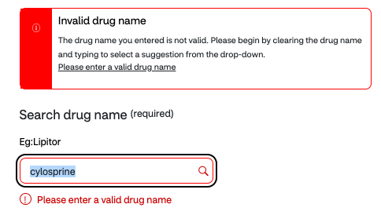
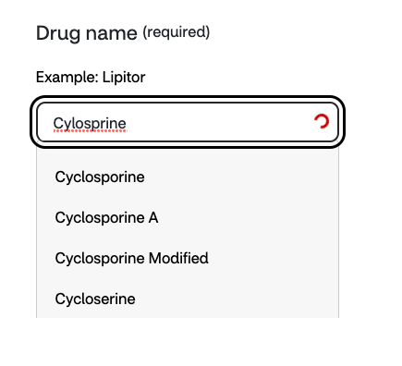
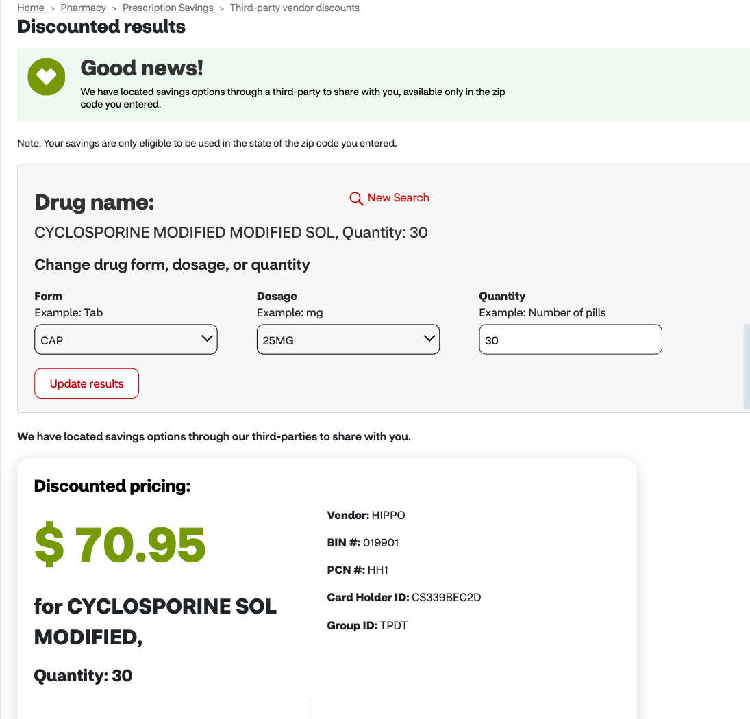
Cash Discount Tool – Search Enhancements Scheduled for Release 2/7
Associated Rally Epic URL:
E14970: Retail Saving Patients Money (SPM) Experiences
Nam N
Before
Non-elastic search for "Cylosprine" (Note: Correct spelling is Cyclosporine)
What we did
Background: The Cash Discount Tool (CDT) allows patients can search for off-benefit, cash-savings discounts from our third-party partners on CVS.com.
Problem: On average, there was 1 error for every visit to the CDT. The majority of these errors (~80%) were due to 'drug name' errors in the drug search field due to misspellings, incompleteness, or special characters. In addition, patients do not have a way to configure their search results by form, strength, and quanity.
Solution: Elastic search will be implemented on the drug search field for CDT so that patients can more easily find the drug name they are searching for. Additionally, a configurable search results page will be implemented that allows patients to configure strength, form, and dosage.
After
Elastic search for "Cylosprine" with configurable search results page
What's the impact
Scheduled release on 2/7/23
​Impact
Reduce the number of errors per visit to the Cash Discount Tool from 1.0 to <0.2
Increase the number of drug searches per visit from 1.0 to 1.1 (10% increase)

Slide 4
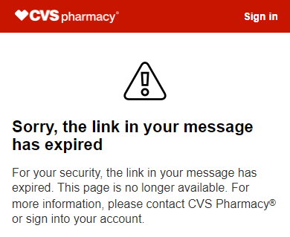
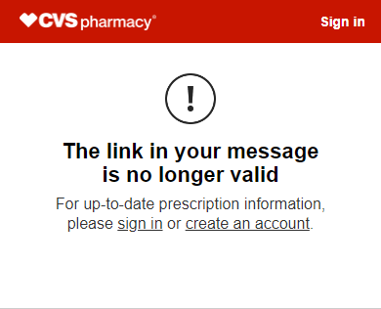
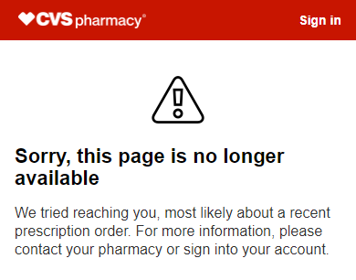
Digital Order Tracker (DOT): Add a sign-in & create account links to error pages
Associated Rally Epic E13770: One Pharmacy Order Status Flow: Consolidation of OS Message
Jessica K
What we did
Background: DOT is a guest experience; patients receive a text when their batch order is ready. The text hyperlinks to the DOT page, and the page includes their batch prescriptions and checkout views. All non-batch orders are sent to the Omni Order Status page.
Problem: Due to security reasons, the link in the text message expires after 72 hours or becomes invalid if the prescription status changes. The error pages informed users that there was an issue but does not communicate the next steps.
Solution: The error pages now have the same supportive content and a link to sign in or create an account. By improving the language of the messages, tagging, and prompt to sign in, we will improve the user experience and boost digital engagement.
Before
After
What's the impact
Released on 12/15/2022
Impact:
1.2M visits the error page
25K sign-ins
9K net new account creations

Slide 5
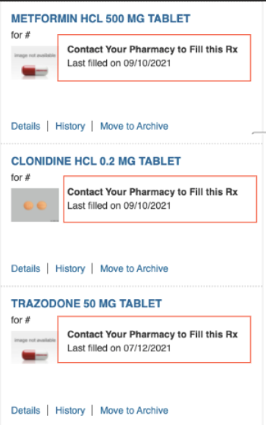

Unlock On Holds – Phase 2
Janet C
Associated Rally Epic URL: E6375: Omni: Enable Patients to fill On Hold Scripts in Retail, Caremark
What we did
Example On Hold Prescription view via CVS App
Problem: Patients are unable to fill a script in an On Hold status and are told to contact their pharmacy. Only new prescriptions can be placed on hold (Fill 00).
Solution: Patients who scripts have been placed On Hold due to return to stock will be able to fill their scripts digitally and not have to call the store.
What's the impact
Phase 2 Q4: Most other known On Holds will be made available to fill, ~120M scripts
Increasing Return to Stock from 90-day time frame to 6 months
Patient Requested On Holds
Continuation of Therapy
We showed “Contact your Pharmacy” ~52M times to patients in 2021
~45M scripts are placed On Hold due to Return to Stock scenarios p/year
Our Projected Digital script lift will be ~1.1M p/year raising our overall penetration by .36 bps
Updated Metrics
•We have seen a total of 1.1M Digital On Hold fills (Phase 1 and 2)
•Week 3 of this year broke a record with 39,143 fills
After

Slide 6

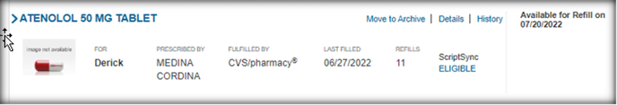
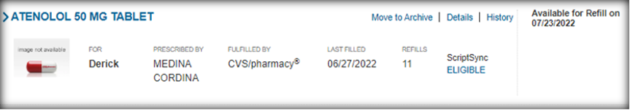
Reduce Refill Too Soon
Janet C
Associated Rally Epic URL:
E8946: Refill Too Soon
What we did
Problem: Patients are allowed to refill their CVS Retail Prescriptions once 80% of their medication was used. Frequently, the Patient’s Insurance will not pay for the medication when the submitted. The results are a Refill Too Soon communication is sent to the Patient. [Top ETMM Patient Pain Point]
Solution: Adjusting the 80% utilization logic so less Patients will receive this Refill Too Soon communication.
Before
What's the impact
This feature was released in July 2022 and has shown good results so far.
Updated Metrics
Before July 2022 release, 2.3% of all Digital fills triggered a Refill Too Soon action note.
We are seeing good results with 1.6% of Digital Fills trigger a Refill Too Soon Action note which equates to a Reduction of 28,000 monthly Refill Too Soon action notes sent to our patients.
After

Slide 7

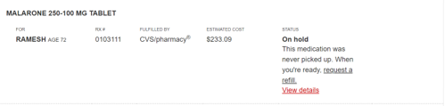
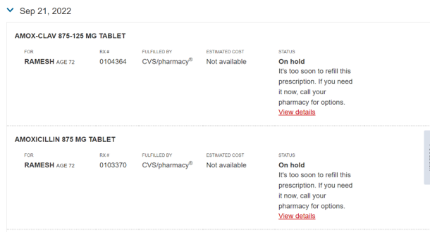
Detailed Recent Orders On Hold Status Scheduled for Release in early PI 1
Associated Rally Epic E13795: Improve On Hold Order Status Experience
Jessica K
Before
What we did
Background: Today, Retail prescriptions that are "On Hold" display on recent orders, pharmacy dashboard, and order details only as "On Hold".
Problem: Customers find the status of “On Hold” confusing on the Recent Orders page as it does not provide clear next best steps to resolve the issue or what the issue is. On average today, there are 3.5 million instances of “On Hold” status viewed on the Recent Orders page. This requires a phone call to the pharmacy to fill the desired Rx. This is a top pain point identified by our Voice of the Customer team.
Solution: Unlock the detailed “On Hold” status on the Recent Orders page. Detailed status includes; return to stock, refill too soon, medication not covered, PA required, and out-of-stock.
After
What's the expected impact
Scheduled for release on 2/7/23
Expect Impact:
Order status CSAT
Order Status Task Accomplishment
Reduce calls

Slide 8
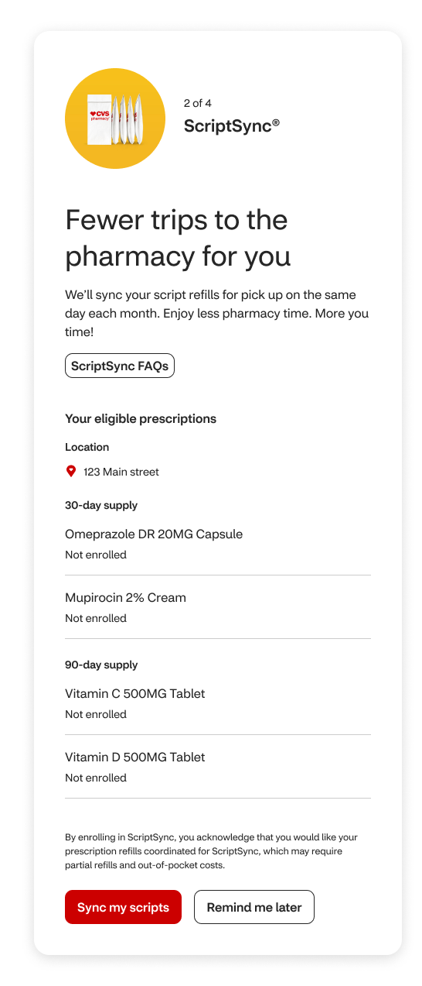
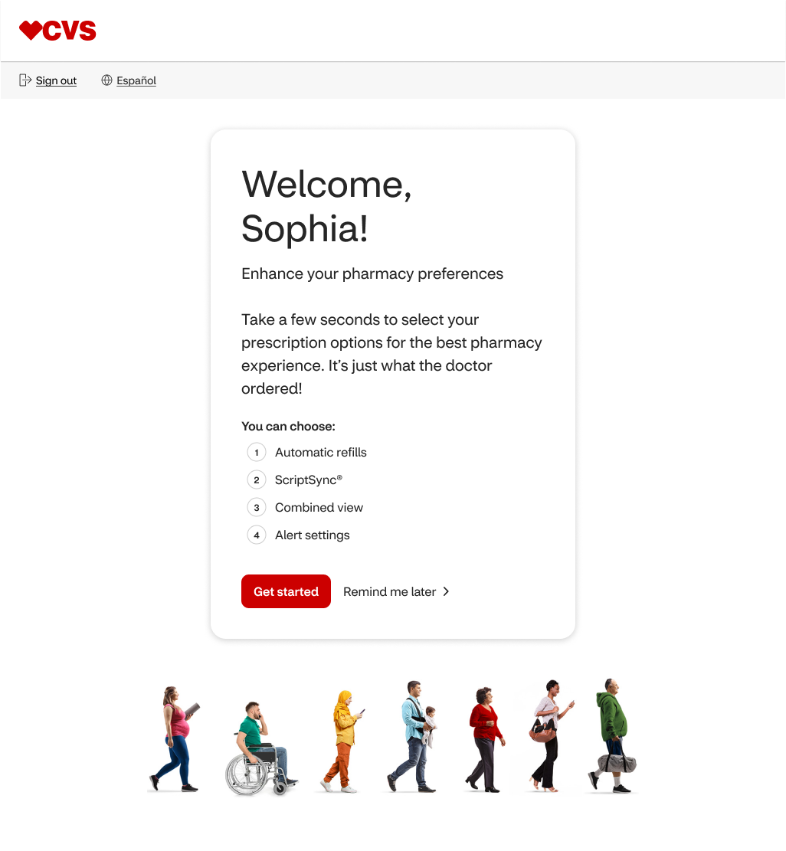
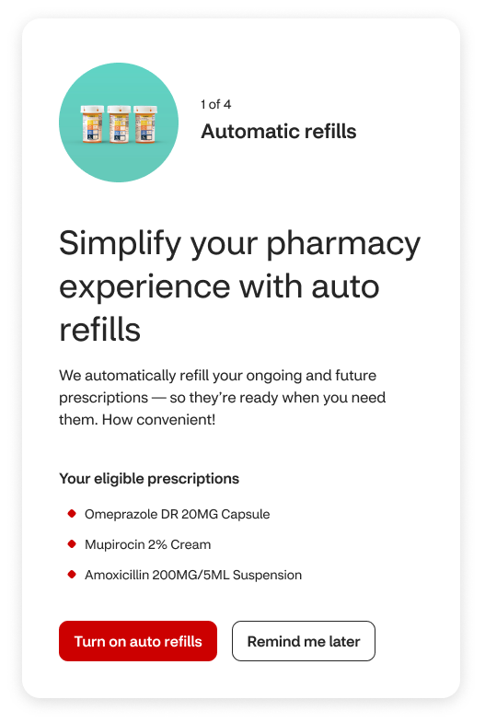
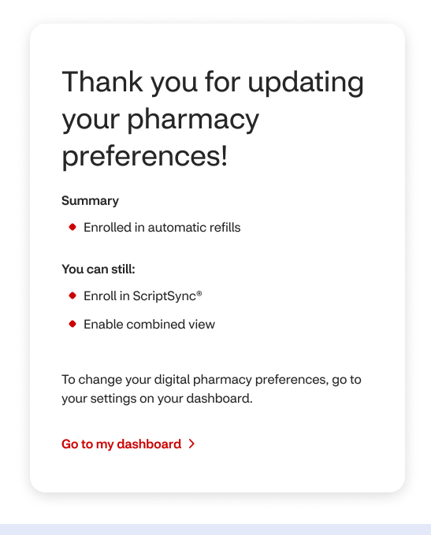
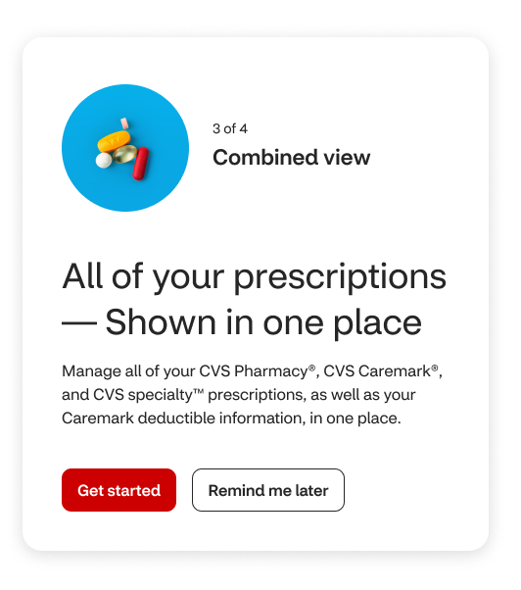
Guided Digital Pharmacy Onboarding Wizard: Web/mWeb MVP
View App Recording
What we did
Release Schedule & Impact
Web/Mobile Web scheduled for 2/7/23 at 15%
UX rollout to App completed in December 2022
>22% of users engage the offer
Increased enrollment over baseline for all 3 programs
+10% growth for AutoRefill
600% growth for ScriptSync
>78% accept ICE/Combined view
Problem: Many users are not aware of Digital products that provide convenient and adherence boosting pharmacy preferences/programs
Solution: We created a guided user Onboarding “Wizard” to promote high value CVS Pharmacy programs to eligible users and allow them to enroll easily with 1-2 'taps’
MVP promotes 3 programs/preferences: ReadyFill, ScriptSync, and consent to view cross-LOB prescriptions

Slide 9
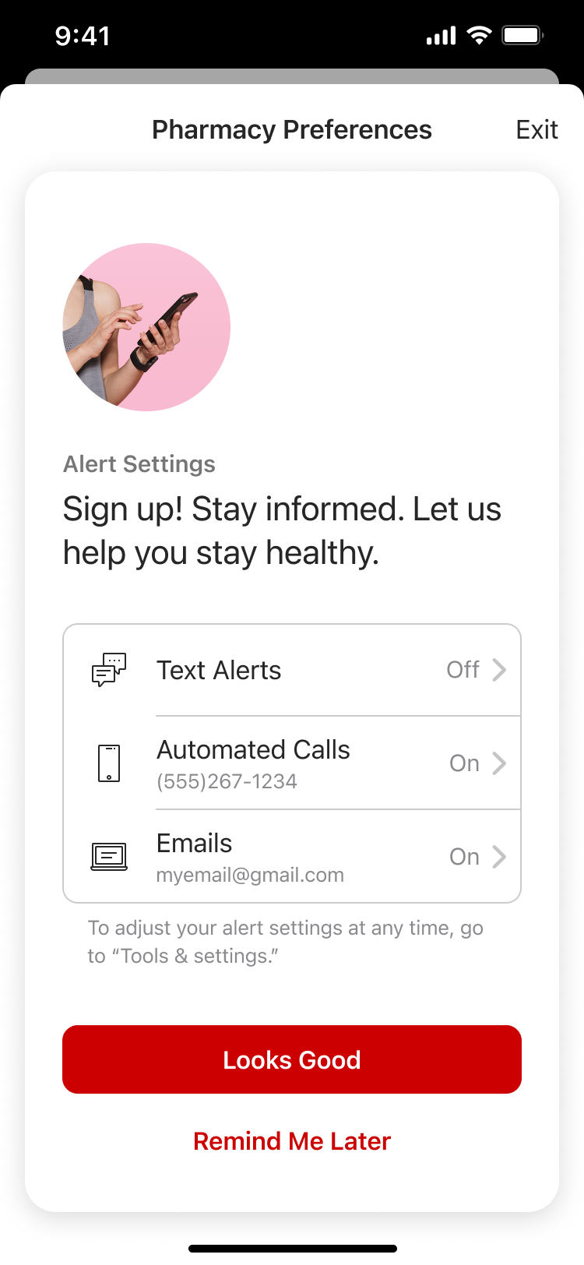
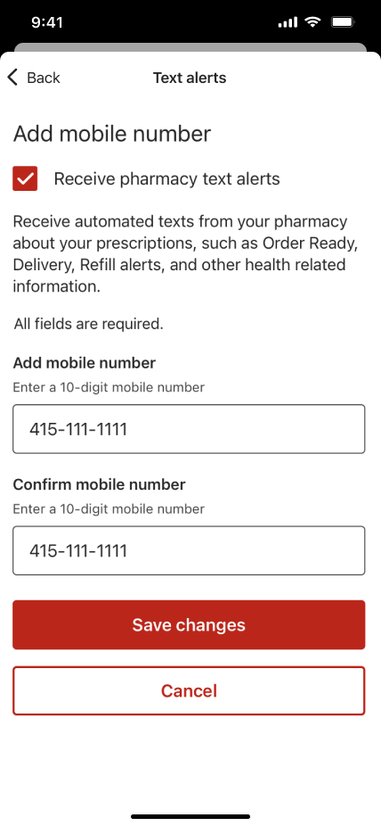
The onboarding flow will enable patients to confirm and update their contact preferences
Onboarding will expand to include pharmacy contact preferences in February 2023
Targets users who are not currently enrolled in SMS
Provides a summary of existing alert settings for SMS, IVR and Email
Encourages user to confirm information & enroll for alerts
Embraces reusability: an existing UI is embedded into the Onboarding flow, for a seamless settings management UX
User taps on the alert type she wishes to edit
The edit alert screen is then embedded into the Onboarding UI, allowing the user to make changes directly from the existing UI
Prevents deep linking to the core contact preferences management screen
Ensures user is returned to the Pharmacy Dashboard
Patient is prompted to review settings. Changes can be applied on the edit screen, which loads when the alert type is tapped.

Slide 10
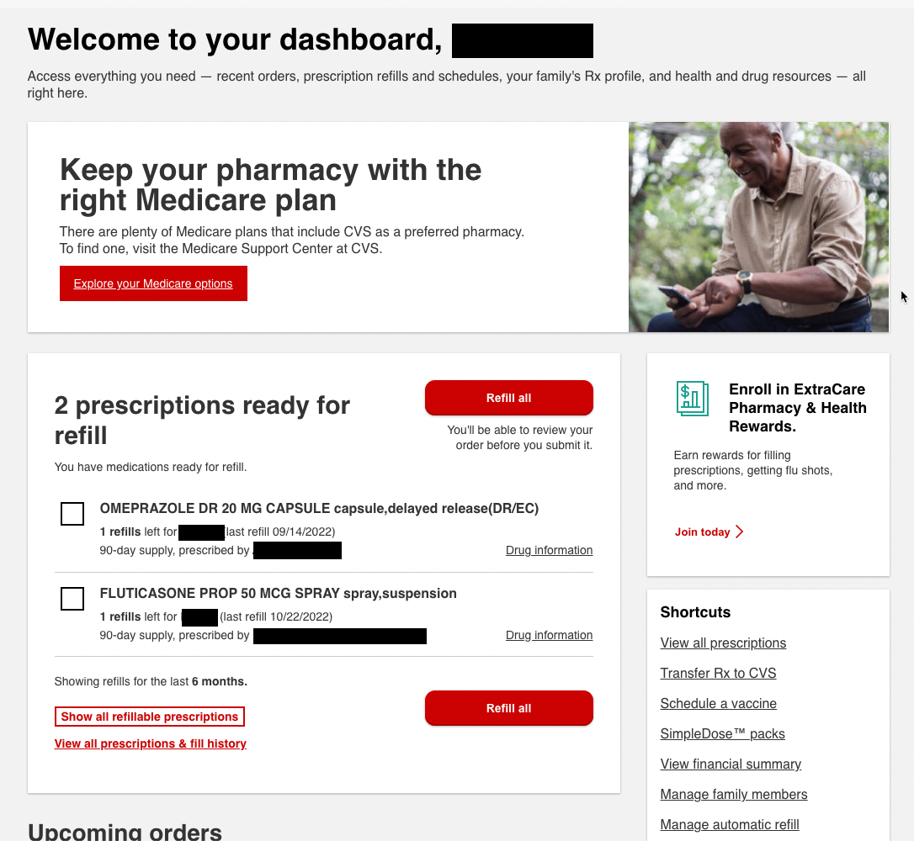
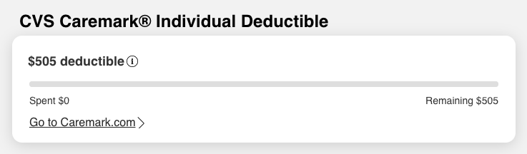
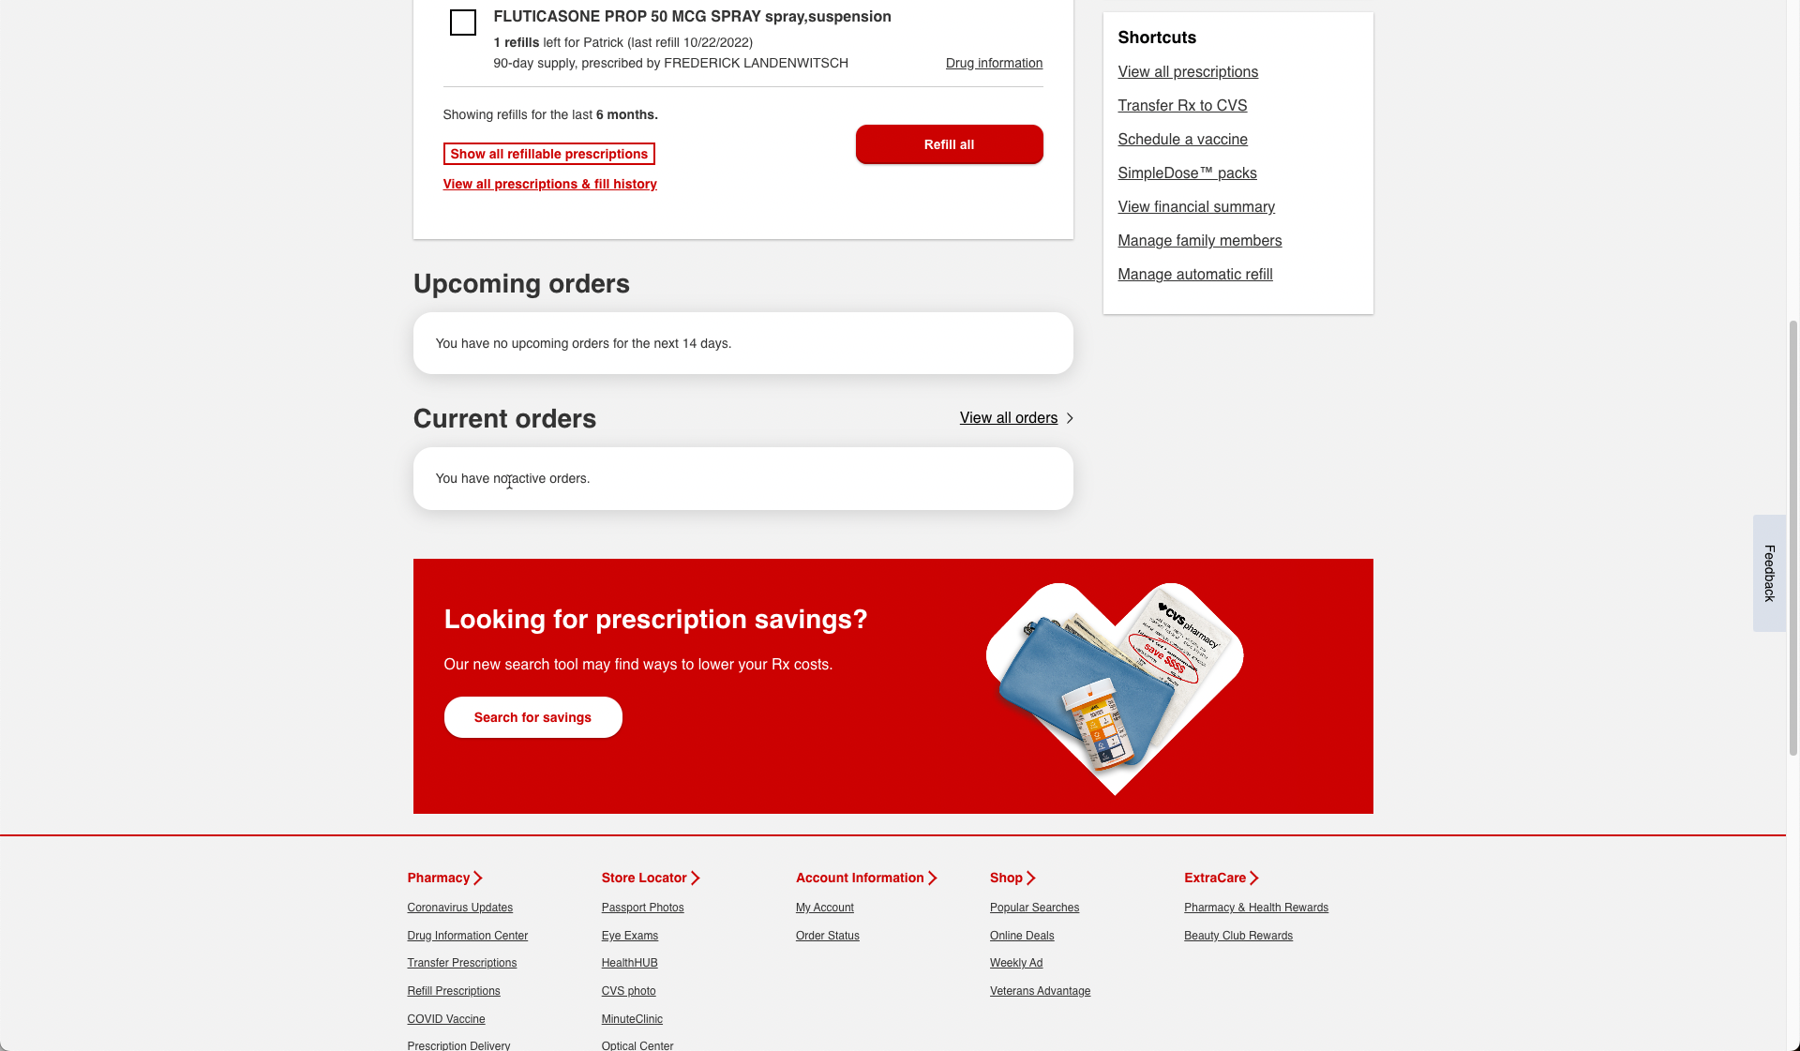
Cross-LOB consent captured in onboarding flow enables Caremark members to view their plan status on CVS.com
Caremark members who opt into “ICE” preference through Onboarding or Pharmacy preferences now see a summary of their benefit plan deductible status on the Pharmacy Dashboard (released 11/17)
~38% of Retail Digital Customers are Caremark Members
Interaction with widget since launch:
311K views (~6.5% of total visits to Pharmacy Dashboard)
1% of customers viewing are interacting (clicking link to Caremark or informational modal)
Deductible will be available on the App Dashboard later this year

Slide 11


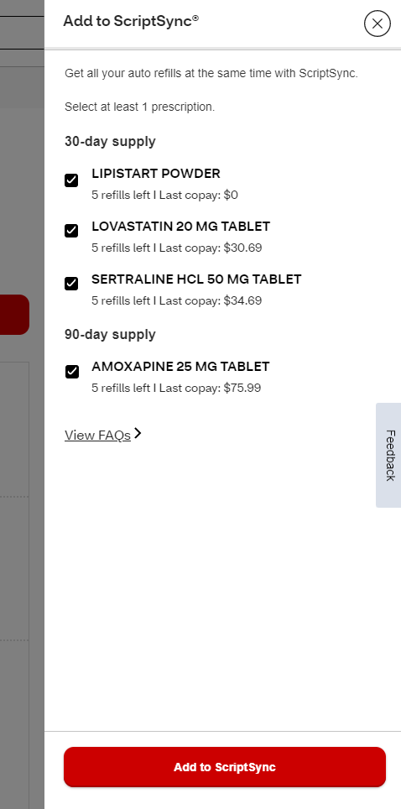
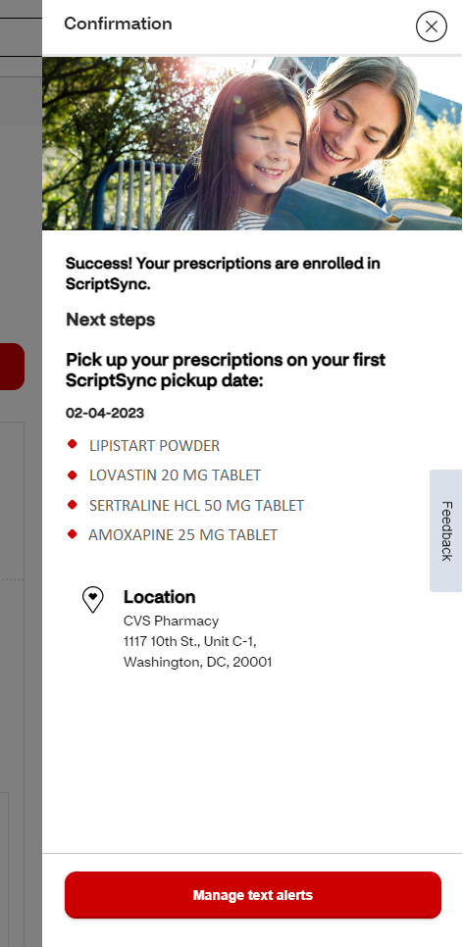
ScriptSync Eligibility Expansion (90D, Pending state) – Live
Jeff M
Associated Rally Epic URL: E8318
What we did
Rx Supply
Rx State
Before
After
Problem: Digital ScriptSync enrollments were not supporting 90D and scripts in Pending state to be eligible to be enrolled or added to ScriptSync. This prevented patients from maximizing the benefit of ScriptSync. * Pending state = in-process, ready for pick up, pending 90D conversion, etc.
Solution: 90-day (11/17/22) and Pending state (11/29/22) scripts were enabled in the standalone ScriptSync enrollment flow
30-Day supply
Non-pending
Pending
90-Day supply
Non-pending
What's the impact
Pending
When comparing the prev. vs next full month of the enhancement being made in standalone flow, we saw:
+1630 BPS increase in SS Eligible Visits to Automatic Refills page
+77% increase in SS Enrollments
+117% increase in SS “Add an Rx” Visits

Slide 12
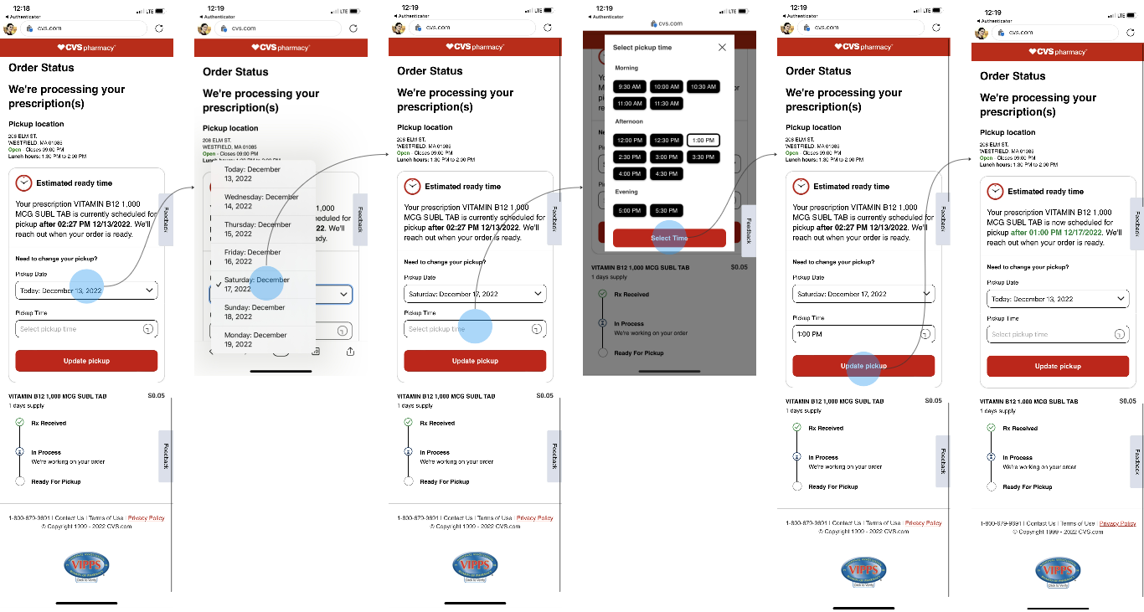
Update Promise Time Schedule - Pilot to 604 Stores
Associated Rally Epic URL: [E12756]: Omni: Set, Re-set & Adjust Customer Pick-up Time Expectation on Digital (aka Promise Time/SLA)
Lindsey B
What we did
What's the impact
Problem Statement: Throughout the core digital experience, patients were unable to self-service update the promise time for their In Process Rxs. Specifically, for patients that click through and land on the RxReceived landing page, ~26% of patients choose to expedite their script, which escalates the script in RxConnect for the pharmacy team to complete the order ASAP without directly updating the promise time. This disrupts the pharmacy workflow and does not allow downstream systems to reflect the updated promise time.
Solution: We are providing patients within the ability to view and update their current estimated ready time (promise time) within the RxReceived Order Status page. Patients can update their promise time to earlier or later than current time, giving pharmacy teams the ability to focus on urgent orders, while ensuring alignment with customer expectations and needs.
Released on 12/8 and throttled to 604 stores as of 1/26 with a plan to release to chain by end of Q1 2023.
Leading indicators from the 90 store pilot:
~2.3% of RxR messages sent and ~11% of RxR Order Status page visits, result in an updated promise time
~79% of updates are to push back promise time, giving the colleagues more time to focus on filling more urgent scripts while continuing to meet the expectations of these patients

Slide 13
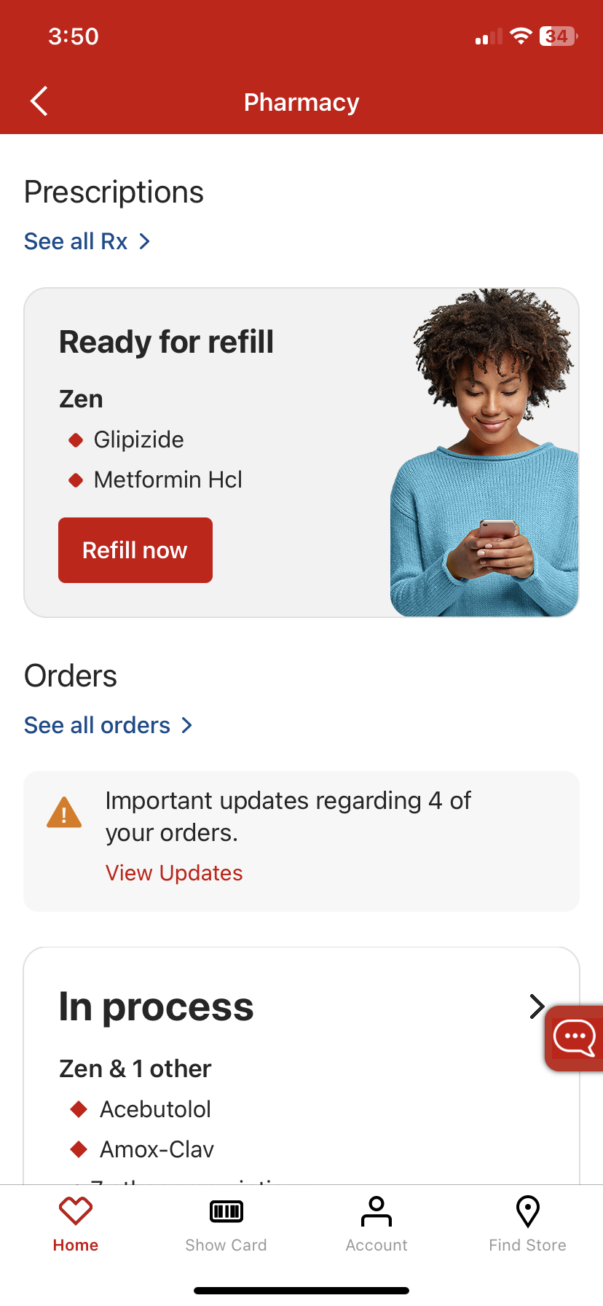
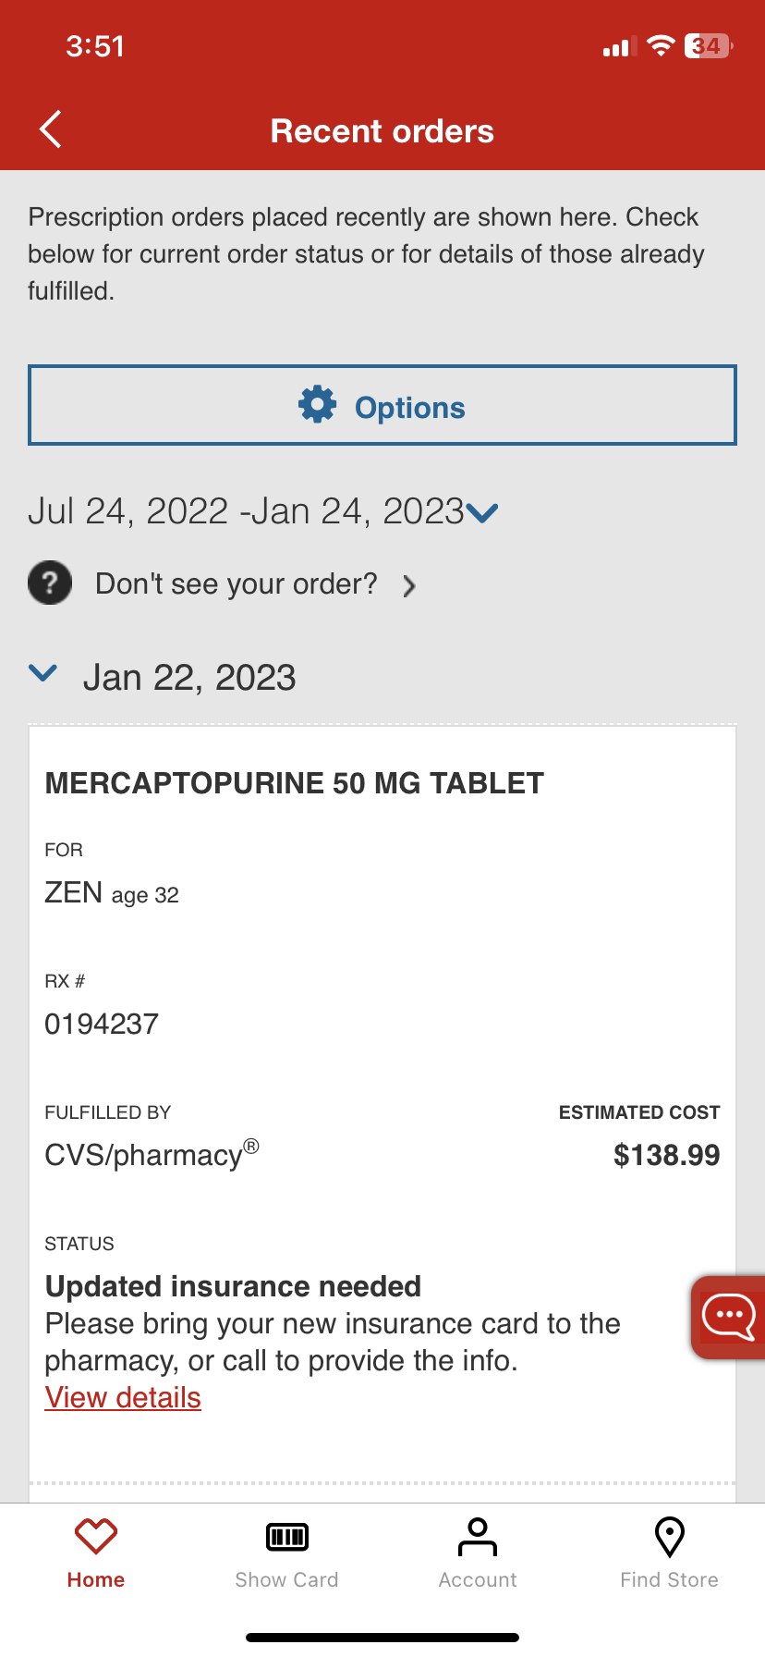
Action Note Banner on the Mobile App Pharmacy Dashboard
Brett F
Planned for Feb. 2023 Release
​Associated Rally Epic URL:
E7368: Omni: CVS Retail App Pharmacy Dashboard Redesign for CVS Retail App
What we did
Problem: Today, pharmacy app users do not have much visibility to Rx impacted by action notes. If they are not SMS enrolled, they will not receive any proactive notification of them, and if they do not seek them out on the Recent Orders page they will be missed.
Solution: Add a new banner in the Orders section of the pharmacy dashboard to alert customers when these common issues affect their prescription fill requests:
Out of Stock - Rx on Order
Updated insurance needed
Your insurance requires approval
Medication not covered by insurance
Awaiting prescriber response
What's the impact
We expect:
Higher CSAT and building value with app experience
Fewer calls to the pharmacy or customer service to inquire about missing Rx refill requests on the app dashboard
In-person engagement with pharmacy to resolve issues and enhance customer experience
21% of visitors to the View all Rx page today are seeing an Rx in one of these action note statuses

Slide 14
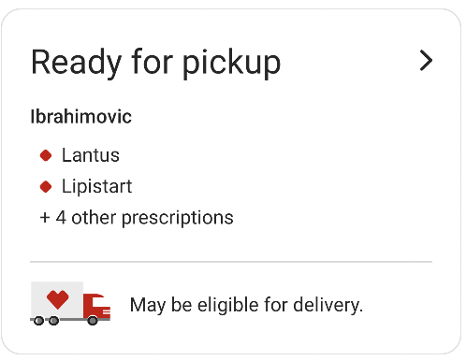
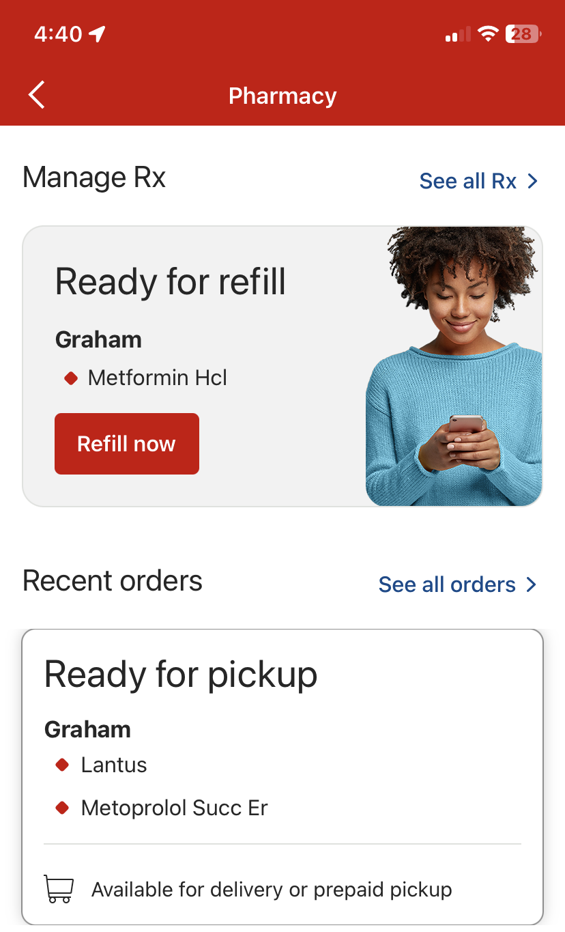
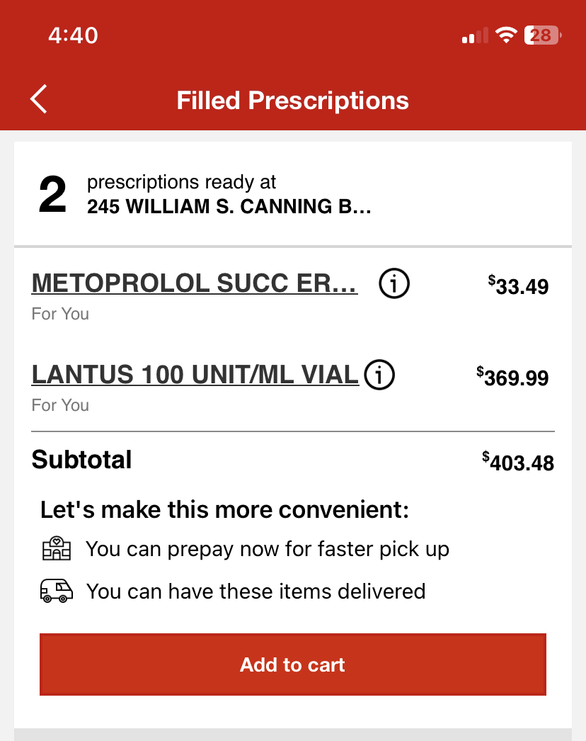
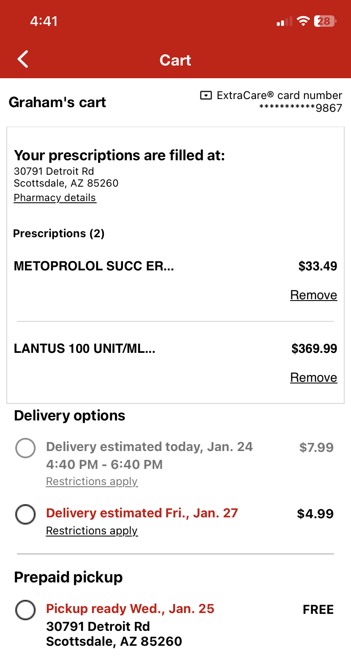
Allow Ready for pickup card to lead straight to the cart for eligible Rx (App)
Brett F
Planned for Feb. 2023 Release
NOW
​Associated Rally Epic URL:
E7368: Omni: CVS Retail App Pharmacy Dashboard Redesign for CVS Retail App
What we did
Problem: Today, we don’t specify which Rx are eligible for delivery or prepaid pickup on the pharmacy dashboard – only that they may be. Customers must tap through to the Rx Summary page and determine which Ready for pickup scripts are eligible. Additionally, the Rx Summary page is duplicative to information exposed in the Cart and Checkout flow, creating a time-consuming extra step.
Solution: Introduce a new Ready for pickup card design that provides a specific eligibility message for the script(s) listed in the card. Cards with Rx eligible for prepaid pickup or delivery lead customers directly to the cart, bypassing the Rx summary page. For Rx that are not eligible, the message directs customers to visit their CVS Pharmacy, and links them to the Recent orders page.
×

NEW
What's the impact
We expect:
Increase conversion rate for delivery/prepaid checkout
34% of customers seeing the Ready for Refill card tap through and reach Rx Summary. From there only 14% continue on to the cart.
Increased CSAT for customers utilizing prepaid pickup or delivery - a simpler checkout flow

Slide 15
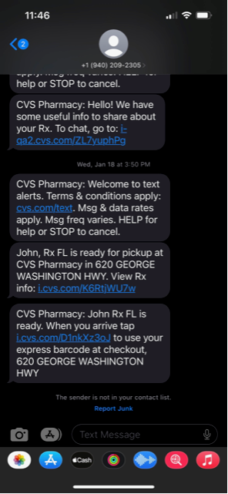
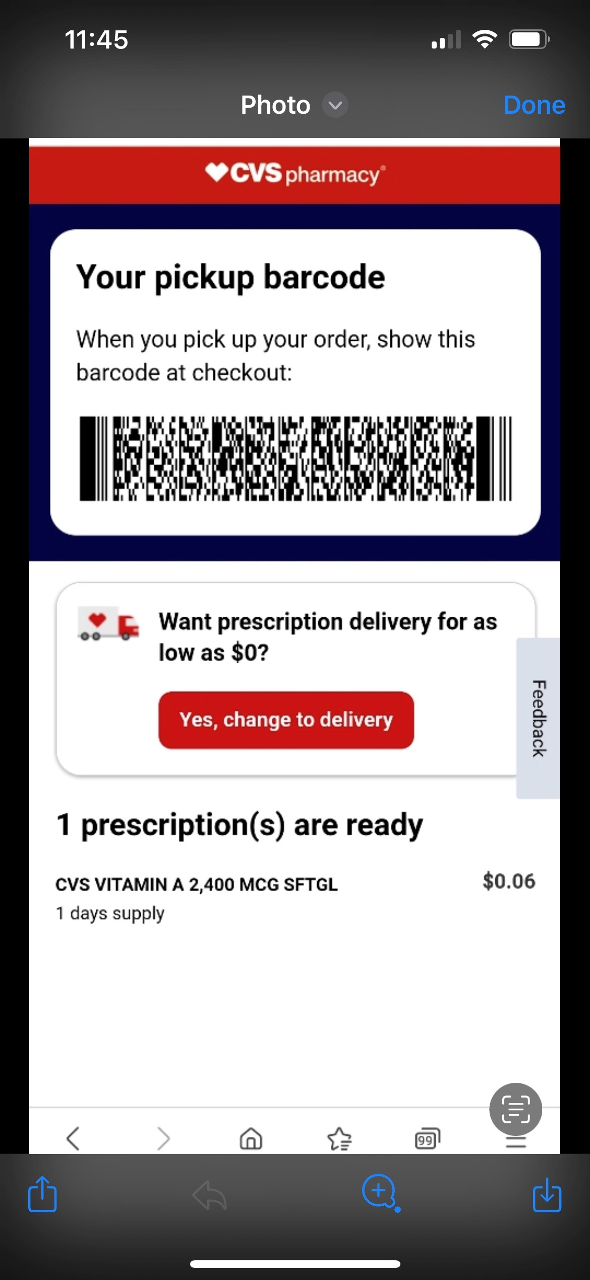
Barcode Pickup on Order Ready Page
Jessica S
​Associated Rally Epic:
E12796 Omni: Lineless pickup & "I'm Here"
What we did
Control SMS
Problem: Today many customers wait in long lines at pickup. Each customer is required to provide name, DOB, and payment to be found in the pharmacy system every time they pick up their medication.
Solution: Provide a barcode on the order ready landing page that can be scanned at the pharmacy counter to streamline the pickup process. Scanning this barcode automatically locates the customer in the pharmacy system including extracare card and any payment on file.
What's the impact
Test SMS with Barcode CTA
We expect:
Increase in barcode usage due to new location on the order ready page (formerly barcode was only located in app)
CTR on RTOR SMS increased 6.6% from 7.1% (control) to 13.7% (test)
Barcode scans as a percentage of all transactions increased 3.7% from 0.3% (control) to 4.0% (test)
33% of customers who viewed the barcode used it at POS to pick up their script
Reduced transaction time for barcode users

Slide 16
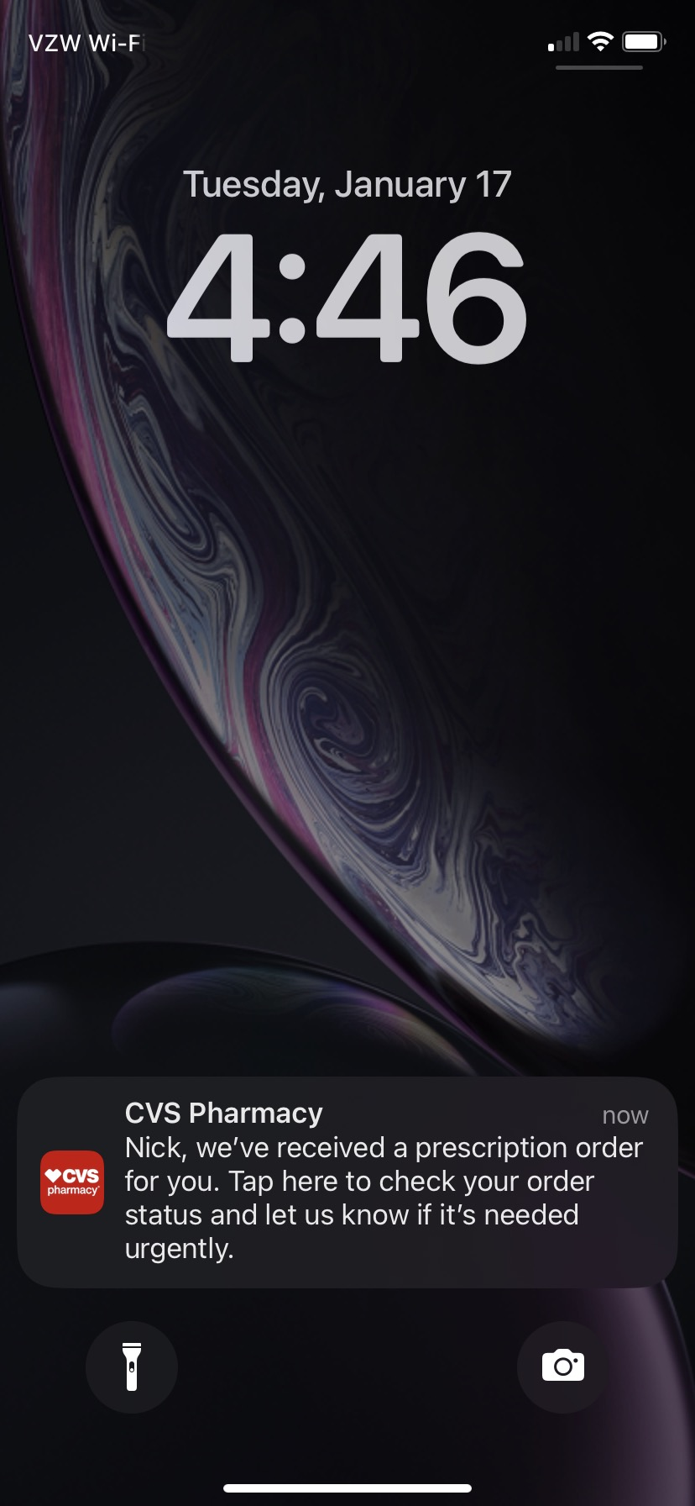
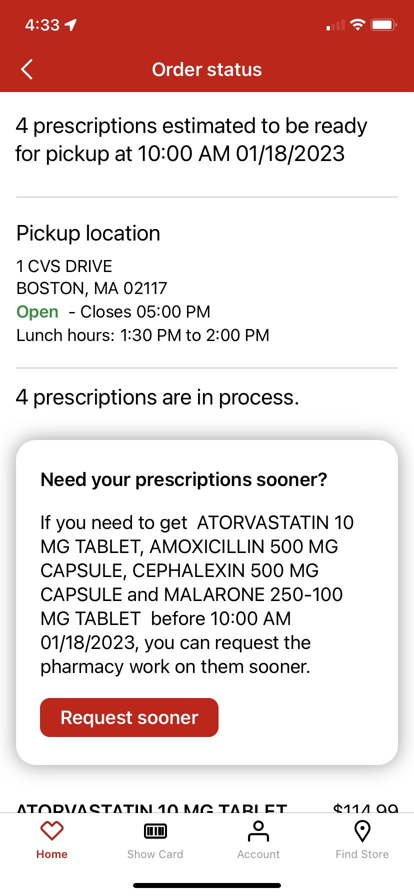
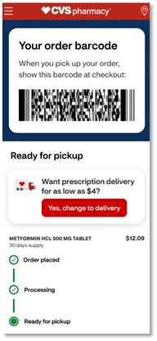
Rx Solution: Lean Team Highlights What we did / What’s the Impact
Prachi J. / Chris R.
RxReceived (RxR) – Expansion and product optimization
Provides patient control and visibility to Rx Ready Time. Patients prompted to create an account, or Rx-Tie, utilizing Easy Account Creation Flow
Reduced messaging time lag. RxR SMS identified median ~2 min. Prior median ~12min
Control group reduction to 2%, queue messages during / after hours, waiting bin check
Removed ability to expedite controlled substances
PI4 Metrics: 28.8M SMS delivered, 9.5M (33%) clicks on links, 7.5M (79%) order status views, 2M Expedites (26%)
Intrado Outage Mitigation - SMS Campaign Migration to EGain
Lean team took on re-platforming SMS campaigns to eGain due to Intrado outage
11 SMS campaigns were migrated to eGain and scaled to chain under 1 month
SMS campaigns migrated: RxReceived (RxR), Real Time Order Ready, 7 Action Notes, IMZ Check-in, IMZ Consent Form
RxOrder Ready Page Enablement and Testing
The Rx Order Ready (OR) page created for barcode test, scaled to support RTOR message. We will conduct test & learn cohorts against the OR flow, enable delivery options, store details, and more enhancements in PI1.
Drove higher barcode utilization in testing (previous slide)
Quickly adapted to support RTOR messaging and flows
RxReceived (RxR) Native App & Push Notifications
Enable RxR experience on Native App to expand reach to patients, drive digital engagement and reduce messaging cost
Jan launch pilot to targeted patients, set RxR foundation in Retail iOS and aOS apps
Enhancements will follow, along with addition of Order Ready and Action Note flows
RxReceived (RxR) Native App & Push Notifications
Delivery option on new RxOR page

Slide 17
PI1 Candidates PI planning 1/30 – 2/3

Slide 18
Onboarding (includes Account and Preferences):
PI1 Work Candidate(s) (Key Features/epics) | Corresponding Rally Epic/Feature? (Add if available) | KPIs Targeted | Customer problem being solved | Primary Train(s)
Allow patients to request 90D supplies at Rx level |  | Increase # of Rxs enrolled in 90D prefernece via Digital | Allow patient to manage their 90D supply preference at both patient level (available in Feb.) and Rx level (targeting March deploy) | MYP
Add 90 day program enrollment offer to the Pharmacy Onboarding UX | E14986 | Increased digital views and enrollment rate % for 90D program | Raise awareness among eligible digital customers of 90D supply preference Make Digital a viable alternative alternative channel for driving 90D enrollment | MYP
Optimize targeting rules and copy within Pharmacy Onboarding flow | E14986 | Enrollment rate % by program | Conversion rates are much higher when users engage program offers through the automated wizard UI vs. The Onboarding re-entry banner | MYP
Launch standalone prompt pilot: a full-screen UI built from Onboarding's UI template, to promote 1 personalized offers, independent of the Onboarding U | E14986 | Increase digital vews and enrollment rate % for PHR Program (tentative) Increase Covax adherence | Increase user awareness of, and enrollment into, PHR program (tentative) Encourage patients to schedule a Covax appointment and adhere to their vaccine schedule | MYP

Slide 19
Adoption:
PI1 Work Candidate(s) (Key Features/epics) | Corresponding Rally Epic/Feature? (Add if available) | KPIs Targeted | Customer problem being solved | Primary Train(s) / Impacted Applications
XID flow enhancement for ORRTS campaign to determine user's registration/Rx tie status: requesting to reserve Arch runway for analysis/Discovery to determine ideal solution to better impact Rx Ties via ORRTS campaigns | TBD: currently in Intake review | Impact to EOY goal of 70% adoption; specific KPIs TBD | Leverage ORRTS campaigns to increase Digital Adoption/Rx ties | Patient Engagement, CRM (?)
Financial Summary: addition of print/download feature in mobile app in support of tax season SMS campaigns being distributed in Feb | TBD: currently in estimation | In 2022, 154K-284K visits to the financial summary page per month AND ~70% of those were via the CVS App; potential impact to this population | Reduction in requests being made to print financial summaries at the pharmacy; reduction in pharmacy requests/lines in-store | Rx Consumer Transaction

Slide 20
Engagement:
PI1 Work Candidate(s) (Key Features/epics) | Corresponding Rally Epic/Feature? (Add if available) | KPIs Targeted | Customer problem being solved | Primary Train(s) / Impacted Applications
Patient Level Tagging and Encryption Solution | E14207: Omni: Engagement - Patient Level Tagging and Encryption Solution | Key Results: Baseline engagement usage at patient level | Currently, Digital is unable to analyze specific retail pharmacy patient behavior from current digital data and tie that patient behavior to operational analytics and insights. | Account, Rx Transactions, Immunizations, Cart and Checkout, Lean team, MYP, Global Experience

Slide 21
Fill Exp: 1 of 4
PI1 Work Candidate(s) (Key Features/epics) | Corresponding Rally Epic/Feature? (Add if available) | KPIs Targeted | Customer problem being solved | Primary Train(s) / Impacted Applications
One Pharmacy Checkout - Building the pharmacy checkout utilizing common components | E14781: One Pharmacy Checkout Flow | KPIs - Monitor Refill NPS Score and Task Accomplishment Authenticated Order Conversion Rate Key Results Reduce number of pharmacy checkout flows from 20+ to 1 | Save valuable coding time Enables consistent user experience and eliminates multiples steps for our users Consistent business rules Easier to test Eliminates extra security work Bring awareness at the time of refill to all available checkout options Allows our train to make our checkout experience The Best | Consumer RxTransactions
One Native App Pharmacy Checkout – Building the pharmacy checkout utilizing common components | E15037: [Native App] One Pharmacy Checkout Flow | KPIs - Monitor Refill NPS Score and Task Accomplishment Authenticated Order Conversion Rate Key Results Reduce number of pharmacy checkout flows from 20+ to 1 | See Above | Consumer RxTransactions
Unlock Retail On Hold Scripts - Create an experience for customers to be able to digitally fill their scripts which have been put On Hold | E6375: Omni: Enable Patients to fill On Hold Scripts | KPIs Improve Retail Refill NPS specific to visits including On Hold Scripts Key Results Unlock potential 3.7% of total Return to stock, 2.2 % of total Patient Requested, and 0.4% of total Proactive/Linked On Hold scripts | Allow our digital retail patients to fill the On Hold scripts that previously required a phone call or a visit to the pharmacy | Consumer RxTransactions / RxConnect

Slide 22
Fill Exp: 2 of 4
PI1 Work Candidate(s) (Key Features/epics) | Corresponding Rally Epic/Feature? (Add if available) | KPIs Targeted | Customer problem being solved | Primary Train(s) / Impacted Applications
Identify medication as a vaccine and do not display as actionable | F86166: Identify medication as a vaccine so that it will display as non- renewable | KPIs Monitor Retail Refill NPS Key Results Remove ability to fill these online | On the CVS digital tools today, we display vaccine medications as refillable/renewable. That is not accurate and causes confusion. | Consumer RxTransactions/RxConnect
Enabling voice command to open the SpokenRx feature on the CVS app | E6629: Spoken Rx Enhancements | Key Results Increase SpokenRx starts | Improve accessibility by opening SpokenRx by voice activation | Consumer RxTransactions
Redesign of Recent Orders screen - Complete tagging | F12675 | Key Results Increase order status NPS One Order Status Flow across LOBs | Improve order status customer experience flow | Consumer RxTransactions
Present canceled/deleted retail refill orders on order summary view | F95948 | Key Results Increase order status NPS One Order Status Flow across LOBs | Customers complain about requesting refill multiple times over because their order disappears. This effort will provide transparency to the customer as to the true status of their order and guide them to contact the pharmacy over repeating unfilled requests. | Consumer RxTransactions
Unlock existing blockers to internal transfers | E12674: Optimize Retail Pharmacy Transfers - Internal and External | Improved CSAT Increased transfer requests | Customers become frustrated when some of their Rxs are not available to be selected for internal transfers. These updates will unluck ready for pickup, on hold, too soon to refill and too soon to renew | MYP

Slide 23
Fill Exp 3 of 4
PI1 Work Candidate(s) | Rally Epic / Features | KPIs Targeted | Customer problem being solved | Primary Train(s) / Impacted Apps
Present retail renewal orders in recent orders summary list with new Denial Statuses based on Action Notes | F122687 | Key Results Increase order status NPS | When a renewal is requested through digital the order is confirmed on checkout but there is no order status during renewal approval. We are adding the renewal order status in February and would like to enhance our users experience by letting them know the renewal has not been approved. | Consumer RxTransactions
Update Retail VOT tracker with new Delayed and in Process statuses | F114321 | Key Results Increase order status NPS One (consistent) Order Status experience across LOB's. | This update will help to provide clarity to statuses that will be filled by the pharmacy but does not require patient intervention. This includes "Out of Stock' and 'Awaiting prescriber response'. We will be introducing the Delayed status in retail to better set the patients expectation that the script doesn't require patient intervention but will take a little longer than a regular in process script. This also helps to better align statuses across LOBs. | Consumer RxTransactions
View All Rxs Page (web) rewrite |  | Increase refill conversion rate Increase refill NPS | Replacing legacy design with a streamlined Rx List component based on Fill Experience North Star that can be used across all LOBs | MYP
View All Rxs page (app) feature enhancements to enable throttle up for Retail patients |  | Increase refill NPS Reduce avg. load time | Allow customers to archive/hide Rxs from native view all Rxs page Allow all users with only Retail Rxs to access the native page | MYP
Show cards for additional order statuses (e.g. pending renewal, upcoming scheduled fill) on Pharmacy Dashboard (app) |  | Increase order status NPS | Raise customer awareness of upcoming one time scheduled Rxs and Rxs with awaiting prescriber response on a renewal request to users viewing their orders summary on Dashboard | MYP

Slide 24
Fill Exp 4 of 4
PI1 Work Candidate(s) | Rally Epic / Features | KPIs Targeted | Customer problem being solved | Primary Train(s) / Impacted Apps
Reschedule upcoming automatic refill orders (app) |  | Increase autofill CSAT Reduce digital autofill disenrollments Decrease RTS rate among autofill Rxs filled for digital users | Digital users today do not have the ability to reschedule upcomingautomatic refills (they can only cancel their orders); this feature will give users the opportunity to match their next refill to a date when they need it and it's convenient for them to pick up | MYP

Slide 25
Omni DESE
PI1 Work Candidate(s) (Key Features/epics) | Corresponding Rally Epic/Feature? (Add if available) | KPIs Targeted | Customer problem being solved | Primary Train(s)
I'm Here – Mobile Pickup Proof of Concept | F125246 Mobile Pickup Proof of Concept: I'm here button & colleague-initiated pickup | Key Results Reduce lines Reduce transaction time | Digitally engaged customers currently have to wait in line to pick up scripts. Creating a mobile check in option for customers with issue-free scripts in the waiting bin will allow to them bypass the line for a quick mobile pickup, reducing wait times for these customers | Lean Team
Out of Stock Action Note resolution via chat | F126194 Test Chat entry via OOS AN to new RxOR page | Key Results Reduction in calls to store Customer engagement with chat | Customers receiving a notification that a prescription is out of stock currently must call the store if they need it filled immediately. Providing a chat option to address this fill issue with prevent calls to the store and provide a self-service option for customer issue resolution. | Lean Team
Create entry points to add card on file for streamlined transaction at pickup | F126238 Add Card on File Entry Point - RxOR page | Key Results Reduce transaction time Increase percentage of customers with card on file | Customers are currently required to provide a physical payment method at every Rx pickup. Adding a card on file will allow colleagues to charge against that card at every pickup without the customer needing to swipe a card. | Lean Team

Slide 26
Lean Team Tests & Support – Test Backlog Iterates Rapidly within these likely Areas
PI4 Work Candidate(s) | Rally Epic | KPIs Targeted | Customer problem being solved | Primary Train(s) / Impacted Apps
RxReceived (RxR) Expansion and Optimization – Channel Expansion for RxR (Fax, VM, Calls), Spanish translation, Send RxR SMS for qualifying action notes, Include Action Notes on landing page, Reduce excluded NDCs, rotational targeted NBAs, Scale R56 to chain | Proactive Order Status E12472 | Capture additional ~1M Rxs/year Patient experience CSAT | Expand RxR reach Improve patient experience with enhanced order status details Better manage patient expectations by providing patient the ability to track in process or delayed scripts with action notes information | Lean Team / Tests only in PI1. ART impacts TBD likely to include RxT, MYP, PE
Rx Order Ready (RxOR) Scaling and Optimization – Include Action Notes, Scale delivery enablement and prepay pick up, enable sign in, COVID test kits NBA, card on file, and other enhancements | Proactive Order Status E12472 | Digital engagement | Provide enhanced order ready, order pickup and delivery experience to patients | Lean Team / Tests only in PI1. ART impacts TBD likely to include PE, CnC
Chat test cohorts - Add chat entry point to Out of Stock action note to evaluate chat as a precursor to self-service tools. Build and test chat platform for converting IVR to chat experience for refills. | Omni Chat LP E14699 | Call reduction Chat utilization | Offer opportunity to resolve action note issues with self service Provide better experience by driving customers to chat and digital from other channels such as IVR | Lean Team / Tests primarily in PI1. Epic level impacts / alignment w PE, B&C
Native App and Push Notifications – Expand reach of RxR, Order Ready, Action Notes campaigns through push notifications and drive digital engagement | Native & Push Proactive O/S E15014 | SMS cost savings Digital engagement | Engage patients in high impact programs such as RxR and RxOR through push notifications and drive app usage | Lean testing only in PI1. Epic level impacts / alignment w RxT, MYP
No Line pickup with "I'm here"/Virtual check in – Create and Test multiple cohorts using RxOR as base landing page with I'm here button, On my way, In store kiosks or monitors, and Virtual lines | Lineless Pickup / I'm Here E12796 | Eradicate lines Reward digital engagement | Create a no line order pick up experience for patients and offer quick transactions through simplified digital experiences. Increase adoption by rewarding digital engagement | Lean testing only in PI1

Slide 27
Non Pod
PI1 Work Candidate(s) (Key Features/epics) | Corresponding Rally Epic/Feature? (Add if available) | KPIs Targeted | Customer problem being solved | Primary Train(s)
Launch Cash Discount Tool on Native (Mobile App) | E14970: Retail Saving Patients Money (SPM) Experiences g E | # of visits to the SPM digital tools | # of errors per visit and # of searches per visit | Benefits
Implement Generic first search experiences on CDT | E14970: Retail Saving Patients Money (SPM) Experiences g | # of visits to the SPM digital tools | Improve CVS prescription price perception | Benefits

